Slide 1
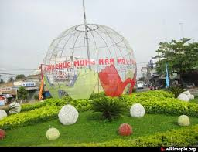

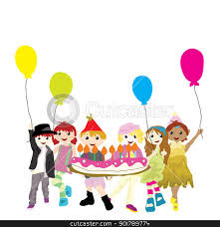

6A2
Welcome to teachers and our class !
TEACHER: Le thi Thanh Truc

Slide 2
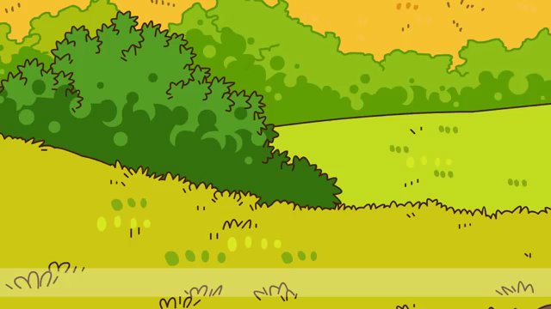

Slide 3
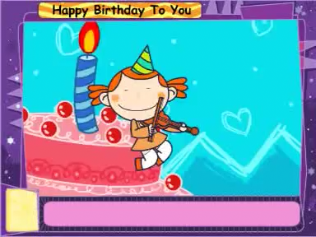
I/ WARM UP:
Sing after the song together!

Slide 4

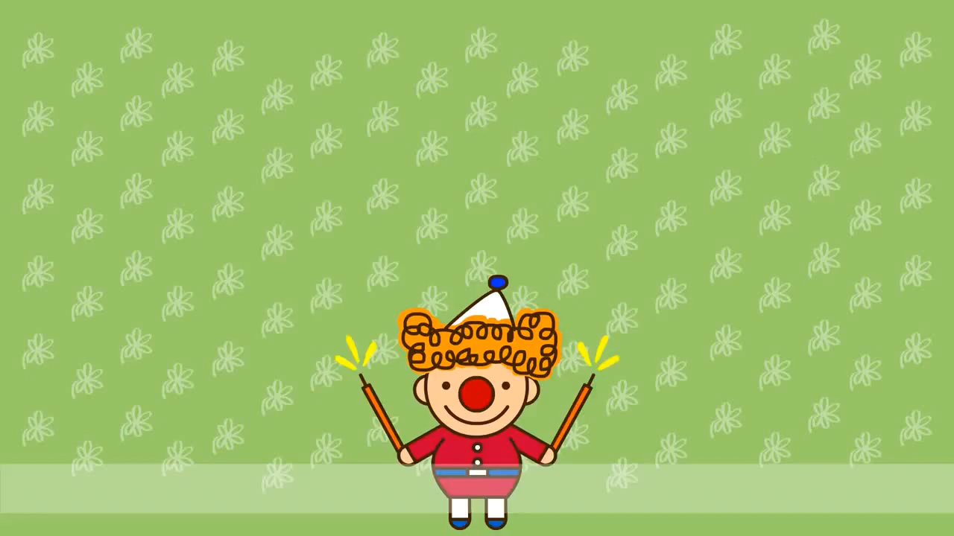
1.WARM UP:
Listen , then write some expressions

Slide 5
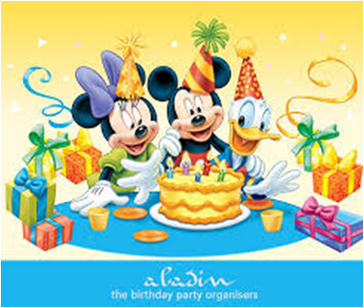
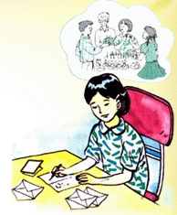
- What will you do on your birthday?
- I will have a party.
How will you prepare for it?
The lesson today will help you write an invitation.

Slide 6

Tuesday, September 27th, 2016
Period 12
Unit 2: Personal information
Lesson 6: B6,7,8
(Writing an invitation card)

Slide 7
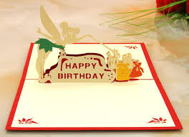
2. PRESENTATION
- What is this?
New words
an invitation card (n)
thiệp mời
- This is …
a birthday card (n)
thiệp sinh nhật
invite (v)
mời
Ex: She will invite some of her friends.
a birthday card
invitation card

Slide 8
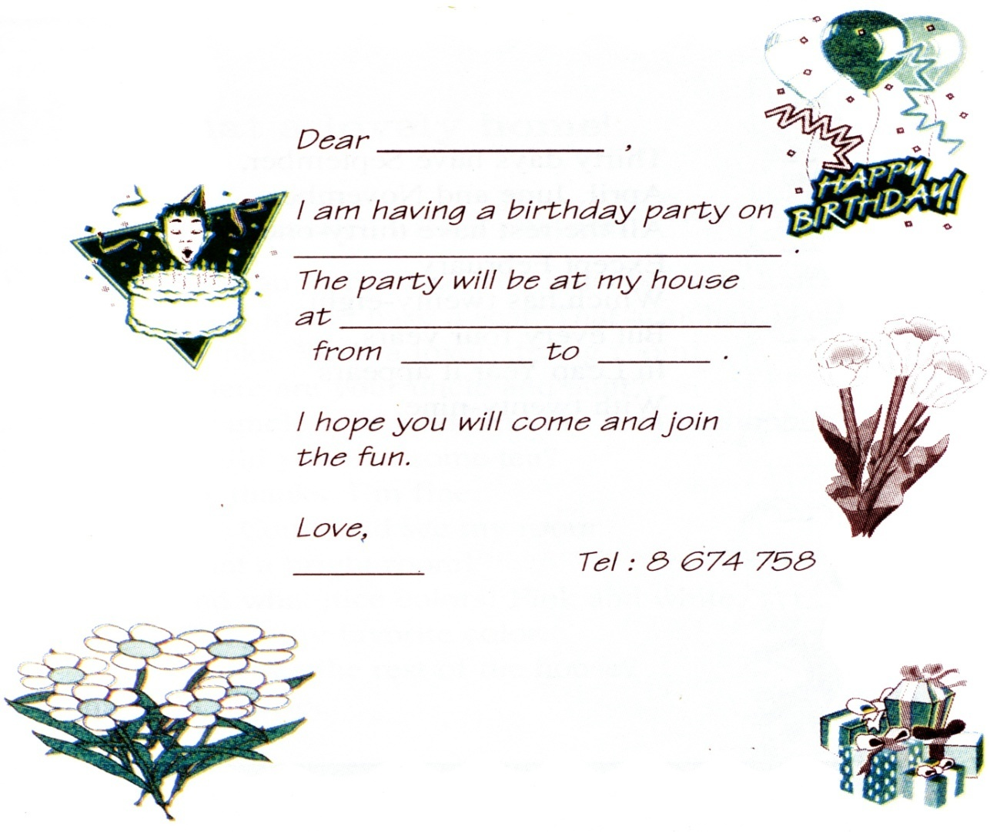
2.PRESENTATION
Read an invitation card
Lan
* Ordering:
A/ Hoa
Sunday, June 8th
(Date)
B/ Lan
12 Tran Hung Dao Street
C/ 5:00 … 9: 00
(address)
5:00 9:00
D/ 12 Tran Hung Dao
Street
(time)
E/ Sunday, June 8th
Key: B-E-D- C- A
Hoa

Slide 9
2. PRACTICE
* Read. Then write
(1/A receiver)
Lan is 12. She will be 13 on Sunday, May 25th. She will have a party for her birthday. She will invite some of her friends. She lives at 24 Ly Thuong Kiet Street. The party will be at her home. It will start at five o’clock in the evening and finish at nine.
(2/ Date)
(3/ Place)
(4/ Time)
Lan
Lan

Slide 10
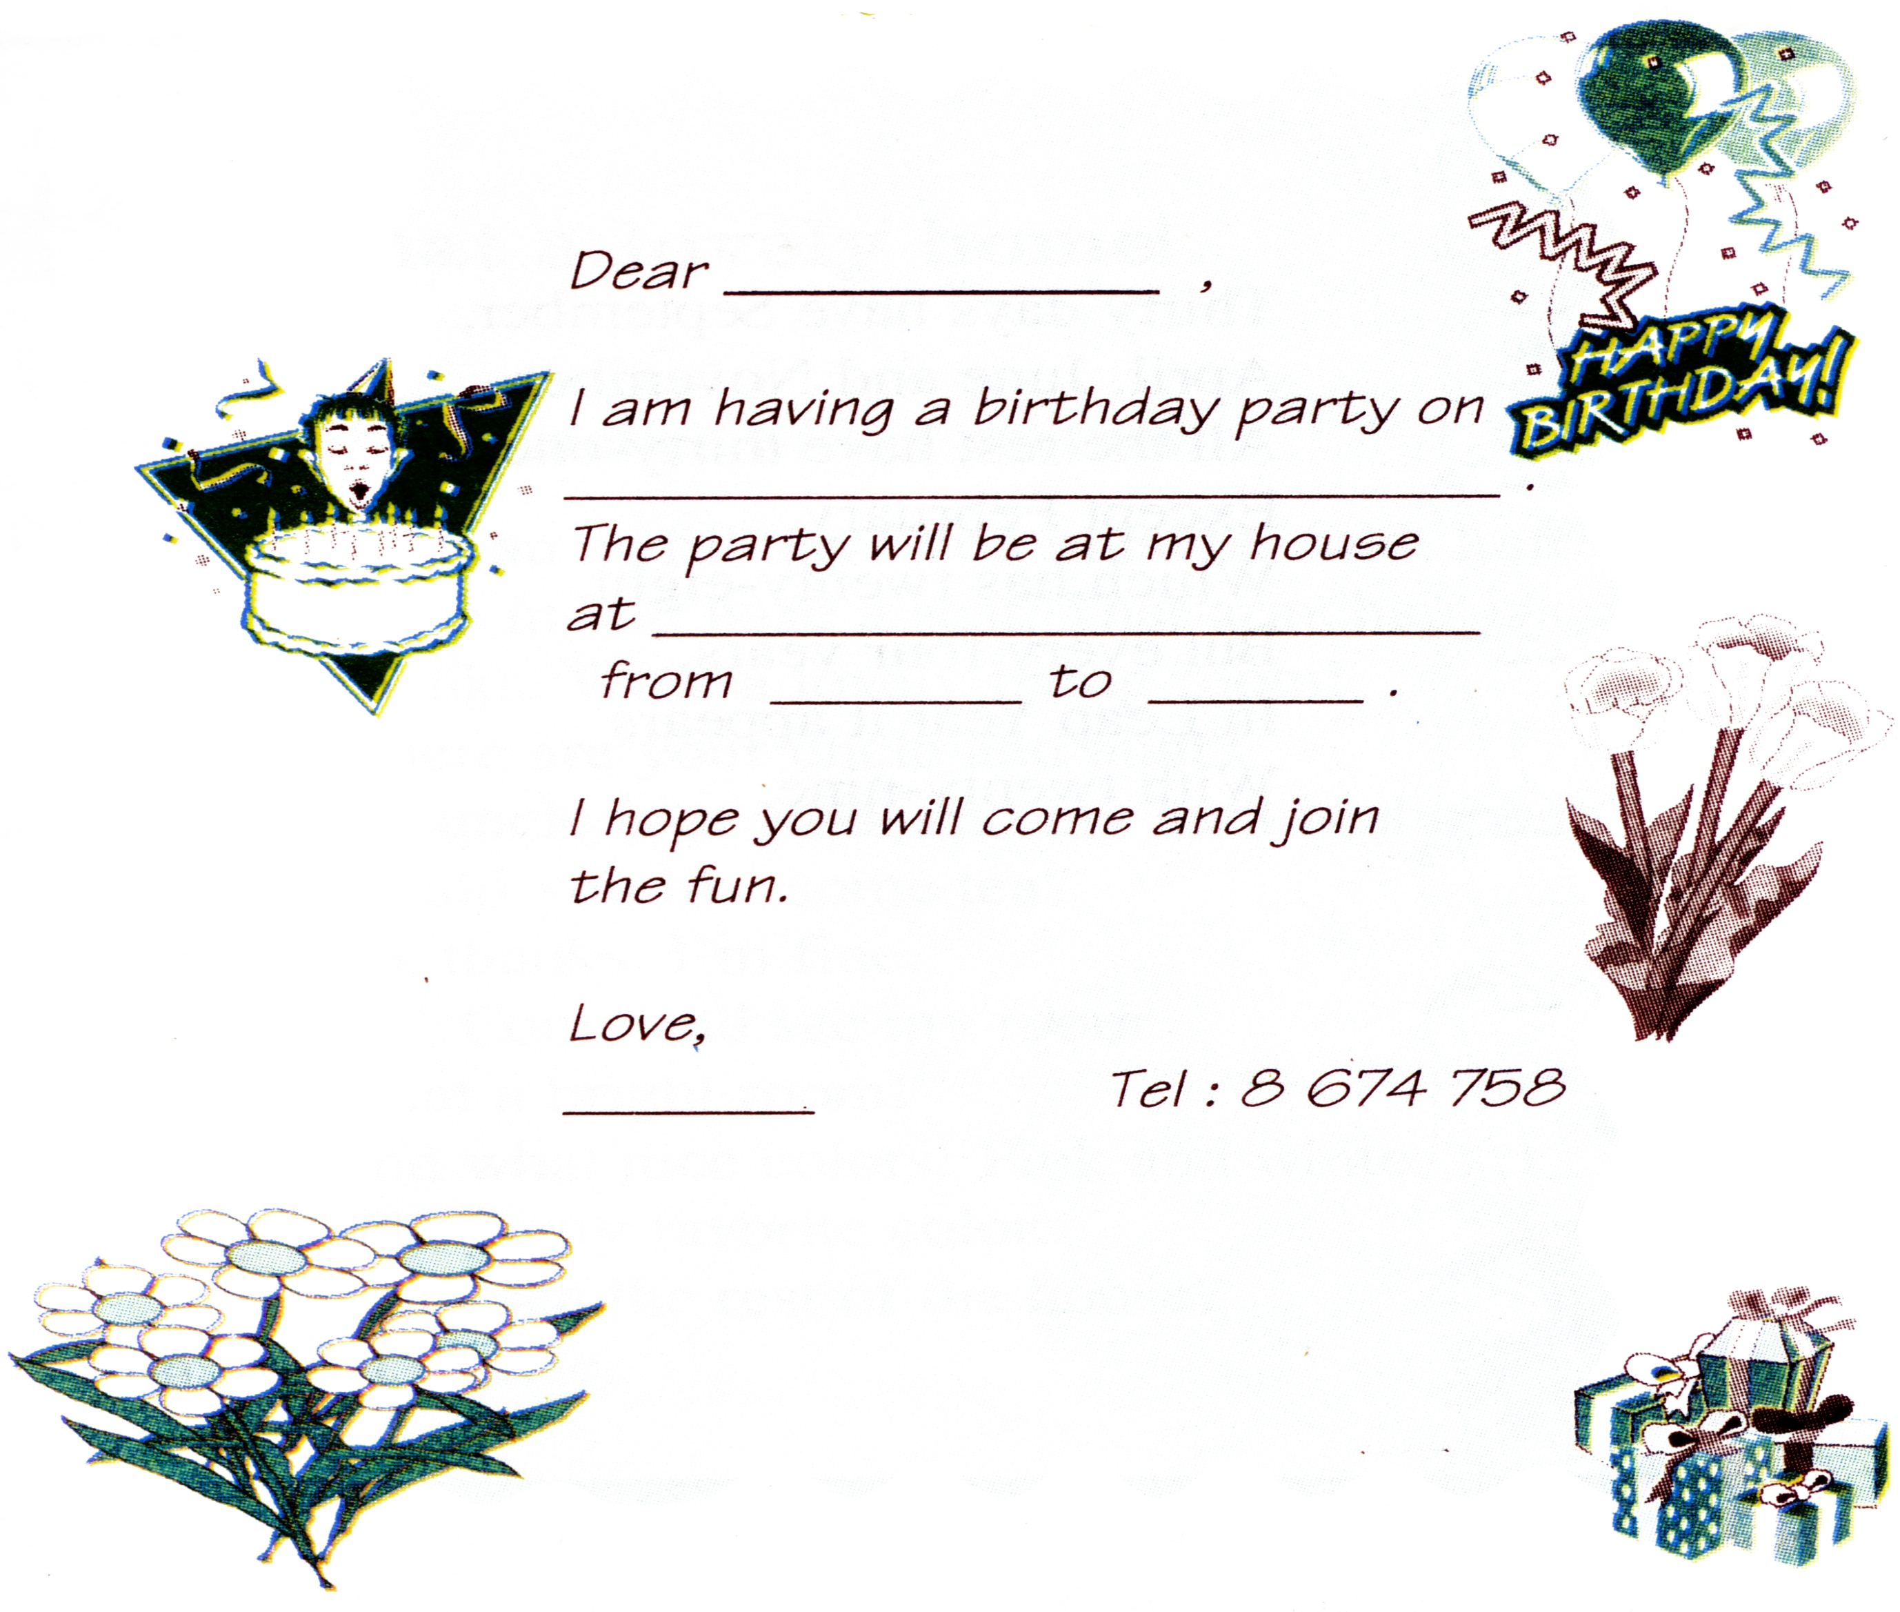
3.PRACTICE
Complete this invitation card
KEY
Loan
Sunday , May 25th
24 Ly Thuong Kiet street
5:00
9:00
Lan

Slide 11
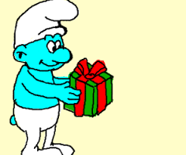
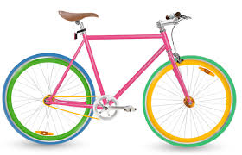
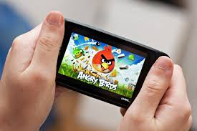

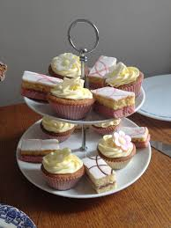
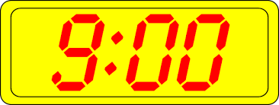
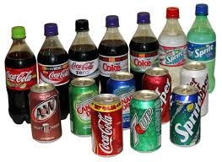
3.PRACTICE
Ask and answer in pairs
a. What will you give Lan?
b. How will you get to her home ?
c. What games will you play ?
d. What will you eat ?
e. What will you drink ?
f. What time will you leave ?
I will …

Slide 12

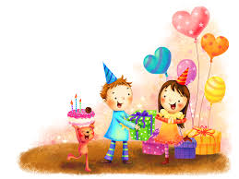
3.PRACTICE
LET’S TALK:
00: 03
00: 01
00: 00
00: 02
a/ - What will you give Lan?
I will give her
a present
a gift

Slide 13
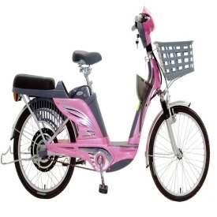
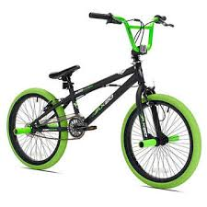
3.PRACTICE
Let’s talk:
00: 05
00: 04
00: 03
00: 02
00: 01
00: 00
b/ - What will you get to her house?
I will get to her house by
electric bike
bicycle

Slide 14
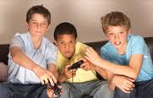
3.PRACTICE
Let’s talk:
00: 03
00: 02
00: 01
00: 00
c/ - What games will you play?
I will play
video games

Slide 15
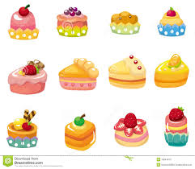
3.PRACTICE
Let’s talk:
00: 03
00: 02
00: 01
00: 00
d/ - What will you eat?
I will eat some
sweets and cakes

Slide 16
3.PRACTICE
Let’s talk:
00: 03
00: 02
00: 01
00: 00
e/ - What will you drink?
I will drink some
soft drinks

Slide 17
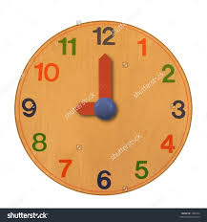

3.PRACTICE
Let’s talk:
00: 03
00: 02
00: 01
00: 00
f/ - What time will you leave?
I will leave at
nine p.m

Slide 18

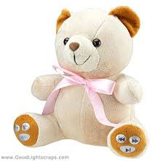
3.PRACTICE
Write:
00: 05
00: 04
00: 03
00: 02
00: 01
00: 00
a/ - What will you give Lan?
I will give her
a present
a teddy bear
a gift

Slide 19
3.PRACTICE
Write:
00: 03
00: 02
00: 01
00: 00
b/ - What will you get to her house?
I will get to her house by
electric bike
bicycle

Slide 20
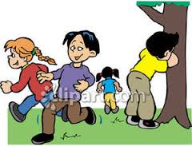

3.PRACTICE
Write:
00: 05
00: 04
00: 03
00: 02
00: 01
00: 00
c/ - What games will you play?
I will play

Slide 21
3.PRACTICE
Write:
00: 05
00: 04
00: 03
00: 02
00: 01
00: 00
d/ - What will you eat?
I will eat some
sweets and cakes

Slide 22
3.PRACTICE
Write:
00: 05
00: 04
00: 03
00: 02
00: 01
00: 00
e/ - What will you drink?
I will drink some
soft drinks

Slide 23


3.PRACTICE
Write:
00: 05
00: 04
00: 03
00: 02
00: 01
00: 00
f/ - What will you leave?
I will leave at

Slide 24

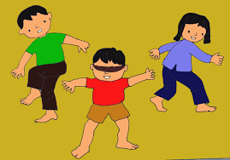
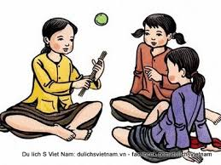
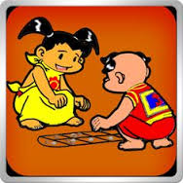
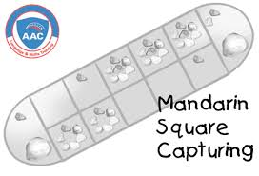
ADVICE:
Traditional Games
TUG OF WAR
HIDE AND SEEK
BAMBOO JACKS

Slide 25


4.PRODUCTION
Write an invitation to your birthday party .
Dear……,
I am having a birthday party on …………....
The party will be at ….
at ……………………
from ……..to ………
I hope you will come and join the fun.
Love,
……..

Slide 26
3.PRoduction
KEY
Complete this invitation card
Huong
Sunday , October 2^{nd,} 2016
24 Le Duan Street, Tan Chau, TN
5:00
8:00
Hanh

Slide 27
4.PRODUCTION/ Advice

Slide 28

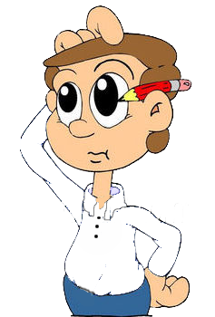
5/ Homework
Learn by heart the new words.
Do exercises and practice again.
Prepare: Unit 11- A2.
a/ Talk:
My birthday
Hi! I am …I will be …I will have ….The party ….
b/ Write: Rewrite an invitation
Dear … ,
I am having a birthday party on …

Slide 29
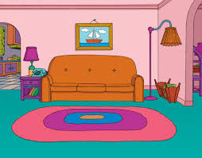
5/ Homework
Learn by heart the new words.
Do exercises and practice again.
Prepare: Unit 11- A2.
c/ Prepare: Unit 3: AT HOME
Lesson 1: A1/ Pages 28,29
1.Things in the living room: a sofa, …

Slide 30
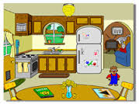
5/ Homework
Learn by heart the new words.
Do exercises and practice again.
Prepare: Unit 11- A2.
c/ Prepare: Unit 3: AT HOME
Lesson 1: A1/ Pages 28,29
2.Things in the kitchen: refrigerator, …

Slide 31
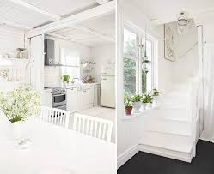
5/ Homework
Learn by heart the new words.
Do exercises and practice again.
Prepare: Unit 11- A2.
c/ Prepare: Unit 3: AT HOME
Lesson 1: A1/ Pages 28,29
3. “ What a lovely home! ”

Slide 32
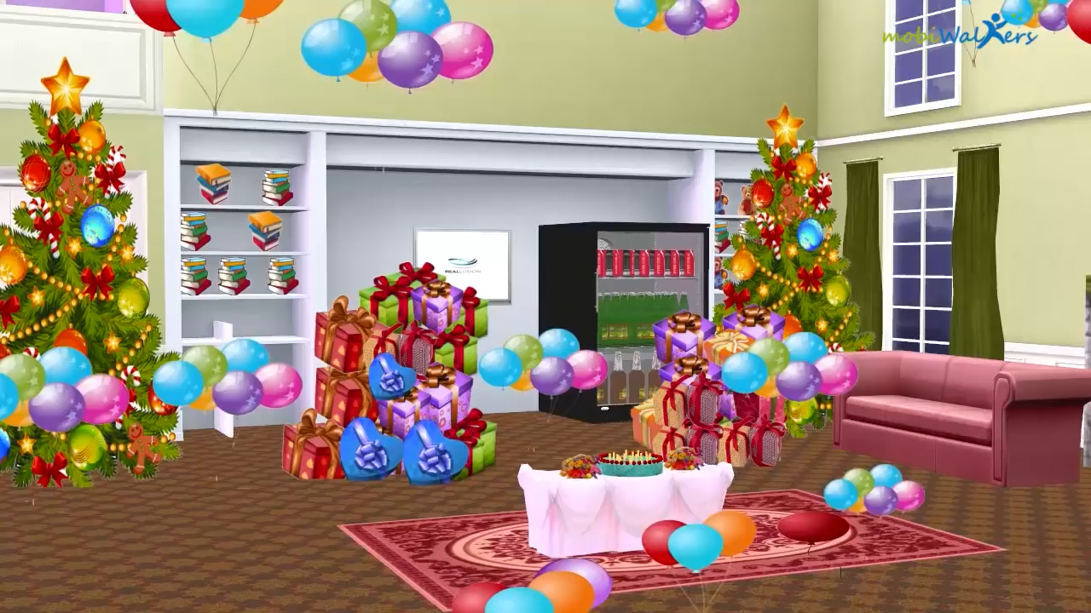
GOODBYE !
SEE YOU AGAIN !
G

